Slide 1
Software Engineering Requirement Gathering
Dr. Kamal Beydoun
Faculty of Sciences I
Lebanese University
If you don’t know where you are going, you’ll end up someplace else.
—Yogi Berra

Slide 2
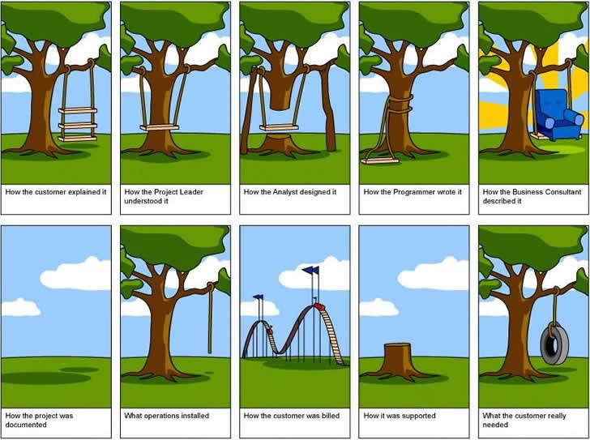
From Spec… to Delivery?

Slide 3
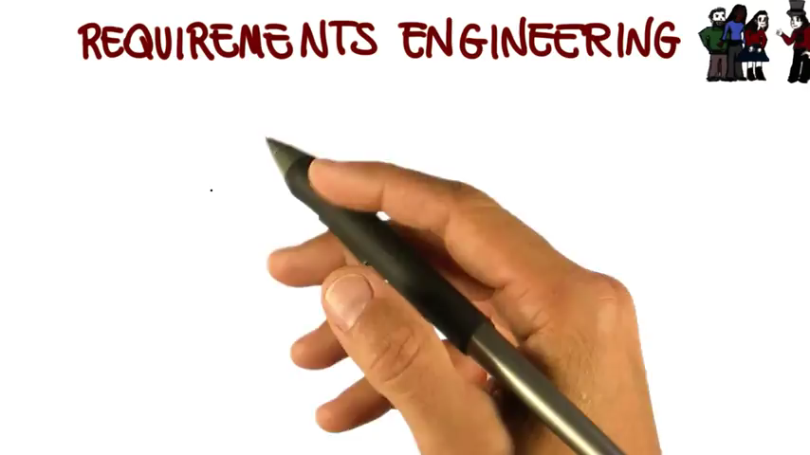
Video – Requirements Engineering

Slide 4
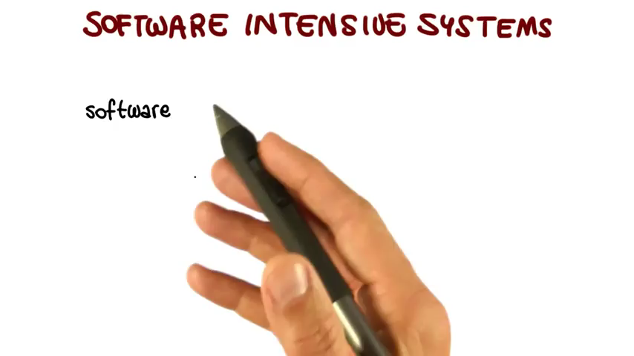
Video – Software Intensive System

Slide 5
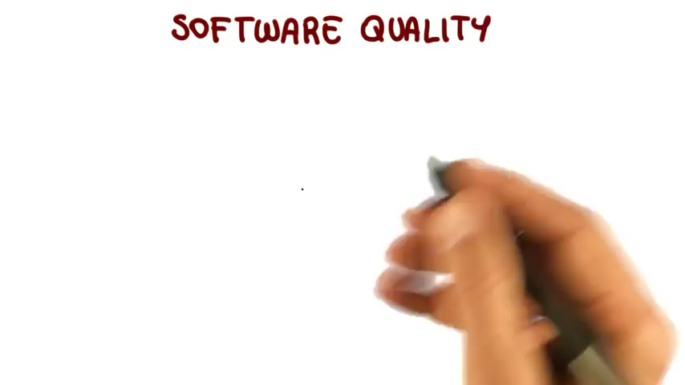
Video – Software Quality

Slide 6
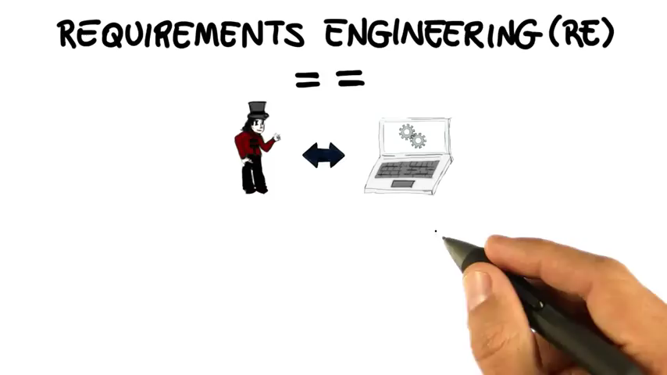
Video – Requirements Engineering

Slide 7
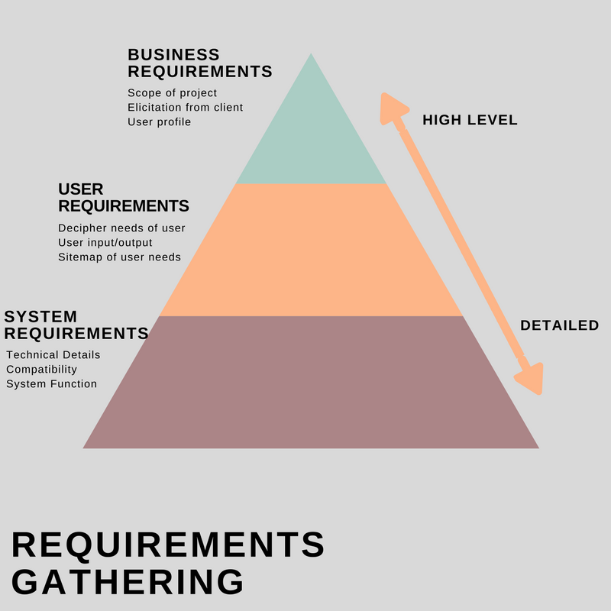
Introduction
Requirement gathering is the most important part of a software project.
After all, if you get the requirements wrong, the resulting application won’t solve the users’ problems.

Slide 8
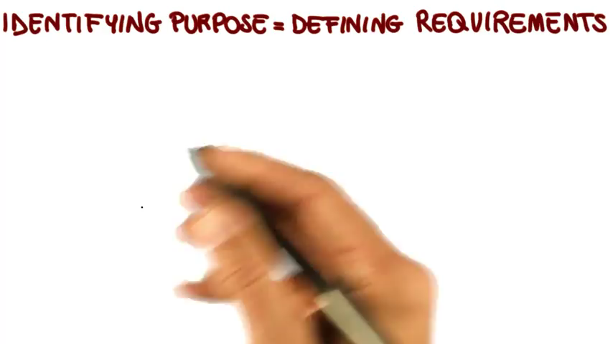
Video – Identifying Purposes

Slide 9
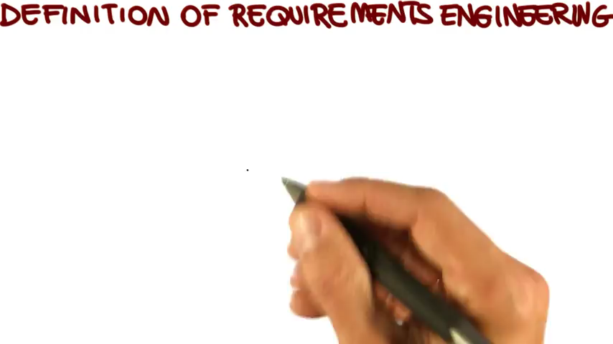
Video – RE Definition Breakdown

Slide 10
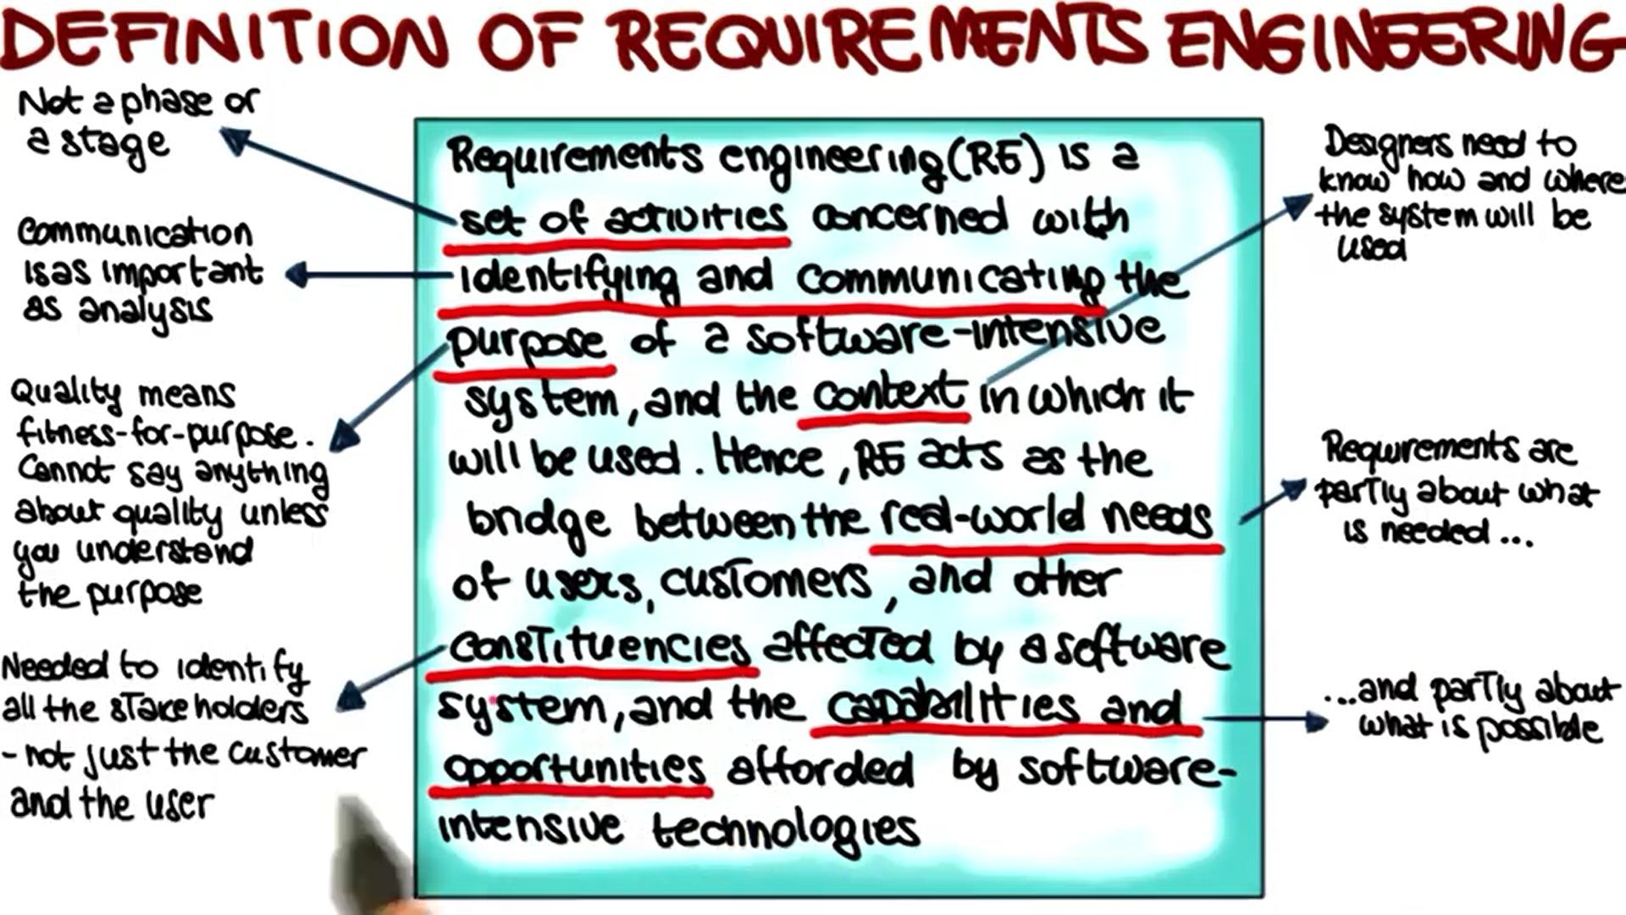

Slide 11
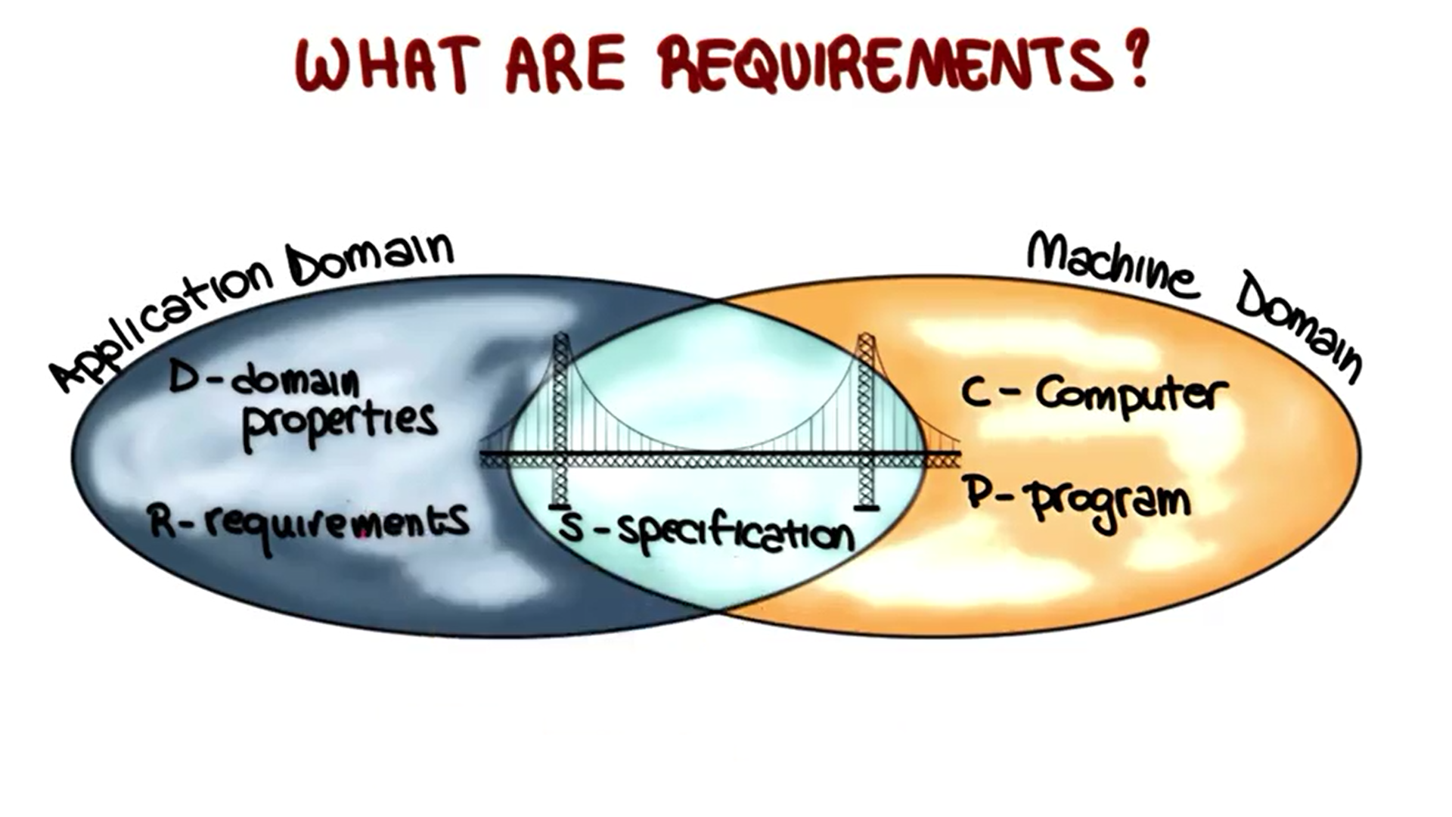
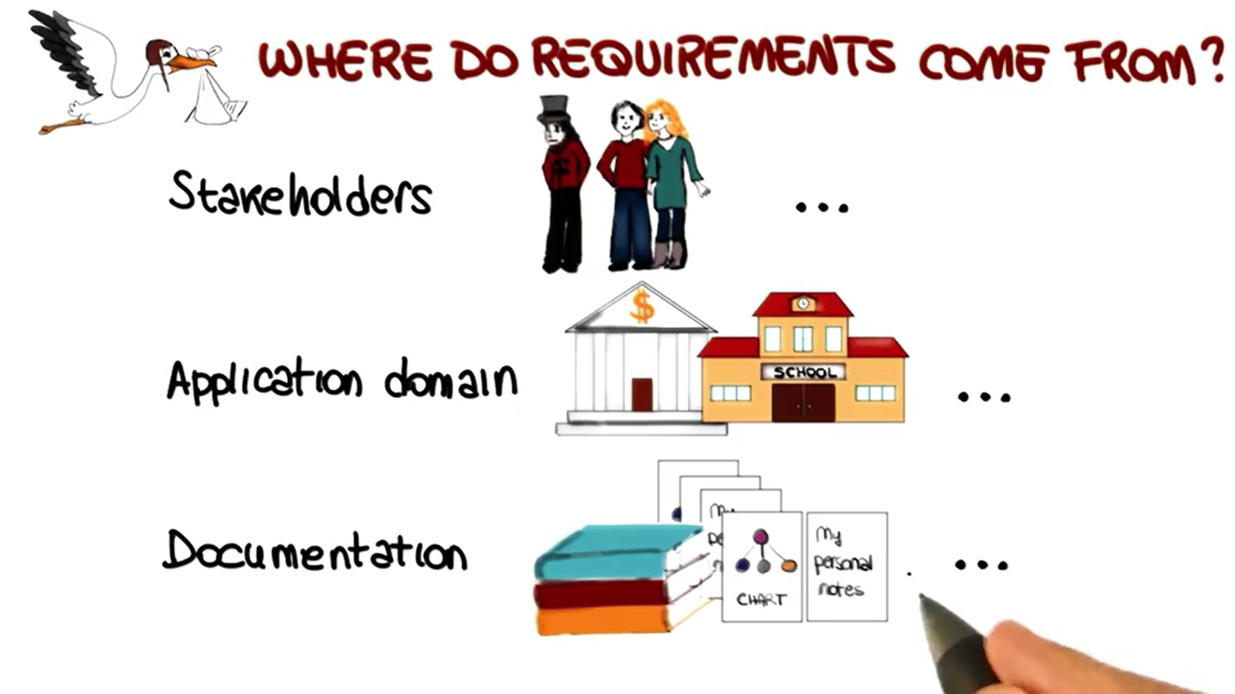
REQUIREMENTS DEFINED
Requirements are the features that your application must provide.
At the beginning of the project, you gather requirements from the customers to figure out what you need to build.
Throughout development, you use the requirements to guide development and ensure that you’re heading in the right direction.
At the end of the project, you use the requirements to verify that the finished application actually does what it’s supposed to do.

Slide 12
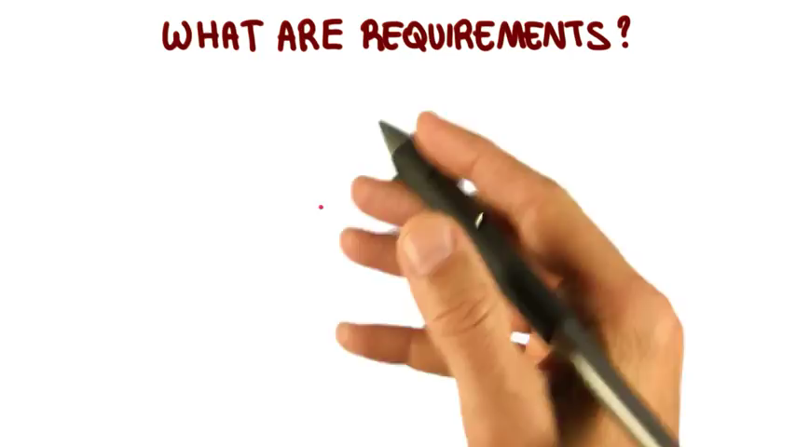
Video – Defining Requirements

Slide 13
REQUIREMENTS PROPERTIES
Clear : Good requirements are clear, concise, and easy to understand.
they can’t be pumped full of management‐speak, florid text, and confusing jargon.
Each requirement must state in concrete, no‐nonsense terms exactly what it requires.
Unambiguous : If the requirement is worded so that you can’t tell what it requires, then you can’t build a system to satisfy it.
Read them carefully to make sure you can’t think of any way to interpret them other than the way you intend.
Notes:
“Find the best route from a start location to a destination location.” This can’t be all that hard. After all, Google Maps, Yahoo Maps, MapQuest, Bing Maps, and other sites all do something like this. But how do you define the “best” route? The shortest route?

Slide 14
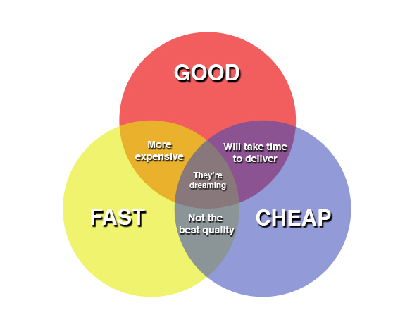
REQUIREMENTS PROPERTIES
Consistent : That means not only that they cannot contradict each other, but that they also don’t provide so many constraints that the problem is unsolvable.
A common software engineering expression is, “Fast, good, cheap. Pick two.”
Only three possible combinations work:
Build something quickly with high quality and high cost.
Build something quickly and inexpensively but with low quality.
Build with high quality and low cost but over a long time.

Slide 15
REQUIREMENTS PROPERTIES
Prioritized: you need to prioritize the requirements. If you’ve assigned costs (usually in terms of time to implement) and priorities to the requirements, then you can defer the high‐cost, low‐priority requirements until a later release.
THE MOSCOW METHOD:
M—Must. These are required features that must be included. They are necessary for the project to be considered a success.
S—Should. These are important features that should be included if possible. If there’s a work-around and there’s no room in the release 1 schedule, these may be deferred until release 2.
C—Could. These are desirable features that can be omitted if they won’t fit in the schedule. They can be pushed back into release 2, but they’re not as important as the “should” features, so they may not make it into release 2, either.
W—Won’t. These are completely optional features that the customers have agreed will not be included in the current release.
Notes:
Let’s face it. If a feature isn’t a “must” or “should,” then its chances of ever being implemented
are slim. After this release has been used for a while, you’ll probably receive tons of bug reports,
requests for changes, and pleas for new features, so in the next release you still won’t have time for
the “could” and “won’t” features.

Slide 16
REQUIREMENTS PROPERTIES
Verifiable: Requirements must be verifiable.
If you can’t verify a requirement, how do you know whether you’ve met it?
The requirements must be limited and precisely defined.

Slide 17
REQUIREMENTS PROPERTIES
Words to Avoid:
Comparatives —Words like faster, better, more, and shinier. How much faster?
Define “better.” How much more? These need to be quantified.
Imprecise adjectives —Words like fast, robust, user‐friendly, efficient, flexible, and glorious.
Vague commands —Words like minimize, maximize, improve, and optimize.

Slide 18
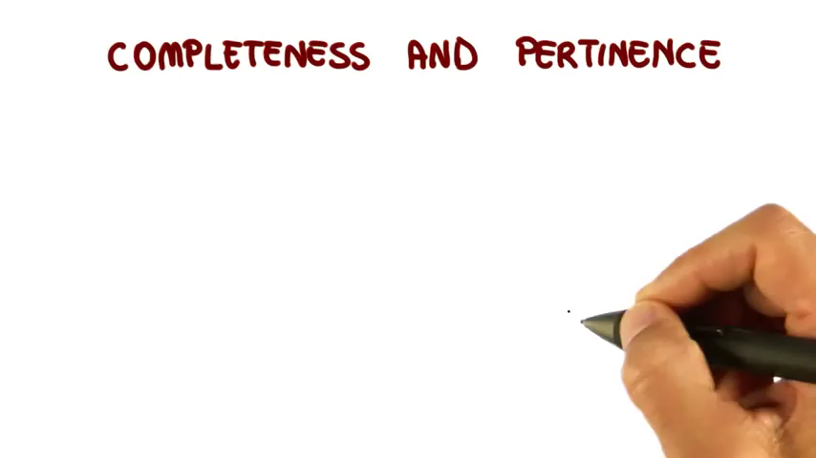
Video – Completeness and pertinence

Slide 19
REQUIREMENT CATEGORIES
Audience‐Oriented Requirements
FURPS
FURPS+
Common Requirements

Slide 20
Audience‐Oriented Requirements
Business requirements lay out the project’s high‐level goals. They explain what the customer hopes to achieve with the project.
The business case is a more marketing‐style document that attempts to justify the project.
User Requirements : They often include things like sketches of forms, scripts that show the steps users will perform to accomplish specific tasks, use cases, and prototypes.
Often they specify what the user needs to accomplish but not necessarily how the application must accomplish it.
Notes:
Notice the word “hopes.” Customers sometimes try to include all their hopes and dreams in the business requirements in addition to verifiable objectives.
They’re more like marketing targets than project requirements. You can craft the best application

Slide 21
Audience‐Oriented Requirements
Functional Requirements: detailed statements of the project’s desired capabilities.
similar to the user requirements but they may also include things that the users won’t see directly (reports, interfaces to other applications).
These are things the application should do.
They not only describe a task that will be performed by the user, but they also describe something that the application will do.

Slide 22
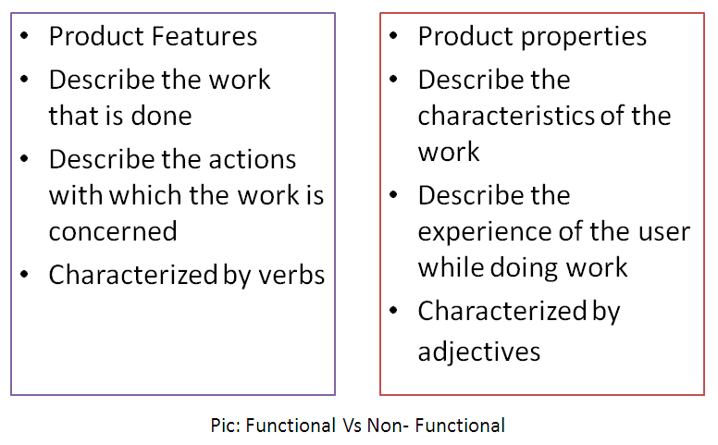
Audience‐Oriented Requirements
Non-functional Requirements : statements about the quality of the application’s behavior or constraints on how it produces a desired result.
performance, reliability, and security characteristics.

Slide 23
Audience‐Oriented Requirements
Implementation Requirements : temporary features that are needed to transition to using the new system but that will be later discarded.
Other implementation requirements include
hiring new staff,
buying new hardware,
preparing training materials,
and actually training the users to use the new system.
Notes:
For example, suppose you’re designing an invoice‐tracking
system to replace an existing system. After you fi nish testing the system and are ready to use it full
time, you need a method to copy any pending invoices from the old database into the new one. That
method is an implementation requirement.

Slide 24
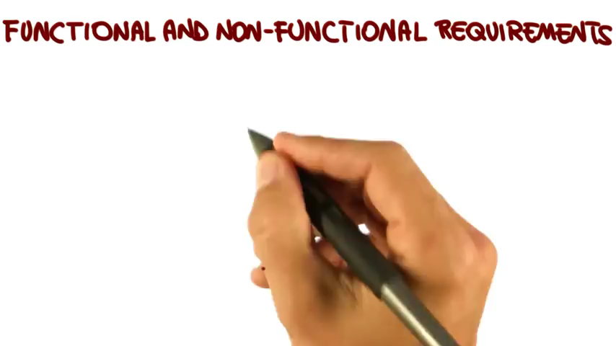
Video – Functional vs Non-Functional Requirements

Slide 25
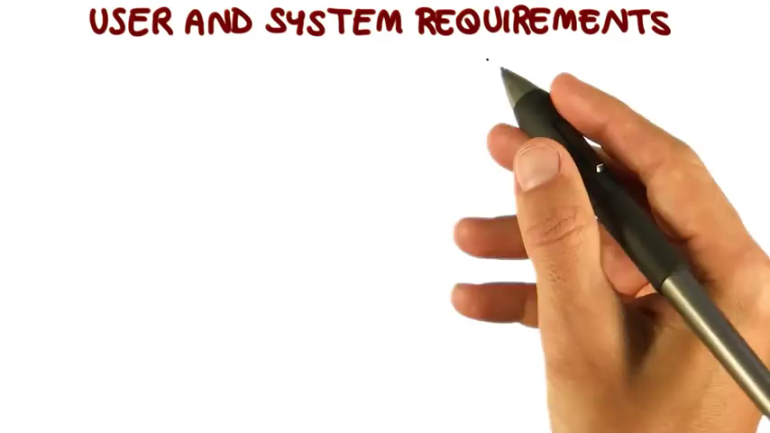
Video – User and System Requiremenst
Notes:
We describe System requirements based on User requirements. Very Important (not mentioned in this chapter of the ebook ).

Slide 26
FURPS
FURPS is an acronym for this system’s requirement categories: functionality, usability, reliability, performance, and supportability.
Functionality —What the application should do.
the system’s general features including what it does, interfaces with other systems, security, and so forth.
Usability —What the program should look like.
user‐oriented features such as the application’s general appearance, ease of use, navigation methods, and responsiveness.
Reliability —How reliable the system should be.
when the system should be available (12 hours per day from 7:00 a.m to 8:00 p.m.), how often it can fail (3 times per year for no more than 1 hour each time).
Performance —How efficient the system should be.
the application’s speed, memory usage, disk usage, and database capacity.
Supportability —How easy it is to support the application.
how easy it will be to maintain the application, how easy it is to test the code, and how flexible the application is. (For example, the application might let users set parameters to determine how it behaves.)

Slide 27
FURPS+
FURPS was extended into FURPS+ to add a few requirements categories.
Design constraints —constraints on the design that are driven by other factors such as the hardware platform, software platform, network characteristics, or database.
Implementation requirements —constraints on the way the software is built.
Interface requirements —constraints on the system’s interfaces with other systems.
Physical requirements —These are constraints on the hardware and physical devices that the system will use.

Slide 28
Common Requirements
Screens —What screens are needed?
Menus —What menus will the screens have?
Navigation —How will the users navigate through different parts of the system?
buttons, use menus, or click forward and backward arrows? Or some combination of those methods?
Work flow —How does data (work orders, purchase requests, invoices, and other data) move through the system?
Login —How is login information stored and validated?
What are the password formats (such as, must require at least one letter and number) and rules (as in, passwords must be changed monthly)?
User types —Are there different kinds of users such as order entry clerk, shipping clerk, supervisor, and admin?
Audit tracking and history —Does the system need to keep track of who made changes to the data?
Archiving —Does the system need to archive older data to free up space in the database? Does it need to copy data into a data warehouse for analysis?
Configuration —Should the application provide configuration screens that let the system administrators change the way the program works?

Slide 29
GATHERING REQUIREMENTS : Listen to Customers (and Users)
Start by listening to the customers.
Learn as much as you can about the problem they are trying to address and any ideas they may have about how the application might solve that problem.
Focus as much as possible on the problem, not on the customers’ suggested solutions, so you can keep the requirements flexible.
If the customers insist on a particular feature that you think is unimportant, ask them why they want it.
Take lots of notes while you’re listening to the customers.
Notes:
Elicitation

Slide 30
GATHERING REQUIREMENTS : Use the Five Ws (and One H)
Who : Ask who will be using the software and get to know as much as you can about those people.
users and customers are the same ?
What : Figure out what the customers need the application to do.
Focus on the goals as much as possible rather than the customers’ ideas about how the solution should work.
When : Find out when the application is needed.
If the application will be rolled out in phases, find out which features are needed when.
Where: Find out where the application will be used. Will it be used on desktop computers in an airconditioned office? Or will it be used on phones in a noisy subway?

Slide 31
GATHERING REQUIREMENTS : Use the Five Ws (and One H)
Why : use the “why” question to help clarify the customers’ needs and see if it is real.
Sometimes, customers don’t have a well-organized reason for building a new system. They just think it will help but don’t actually know why.
How : you shouldn’t completely ignore the customers’ ideas.
Sometimes, customers have good ideas, particularly if they relate to existing practices.

Slide 32
GATHERING REQUIREMENTS : Study Users
Often customers (and users) won’t tell you everything they do or need to do.
they consider trivial but that may be important to the development team.
Pay attention to how they do things.
Look at the forms they fill out (paper or online).
Figure out where they spend most of their time.
Look for the tasks that go smoothly and those that don’t.

Slide 33
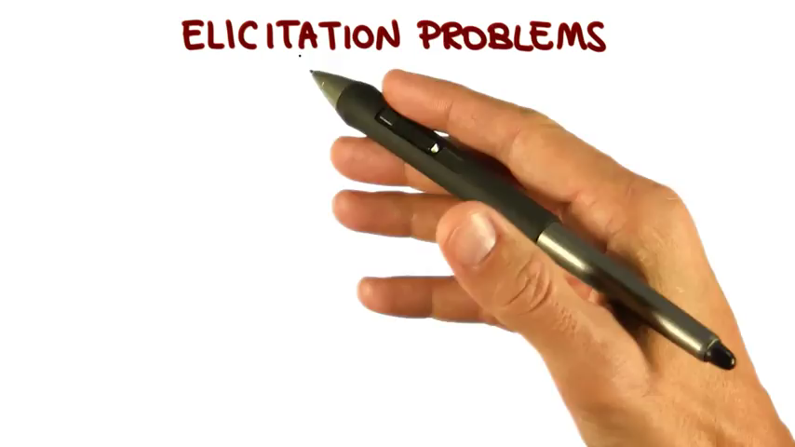
Video – Elicitation Problems

Slide 34
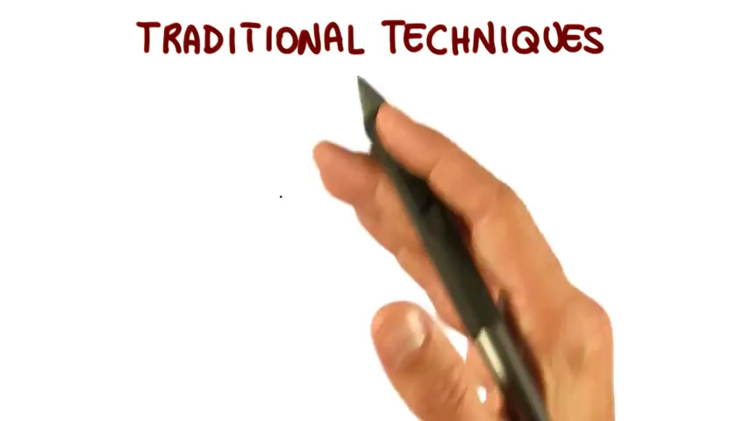
Video – Traditional Techniques

Slide 35
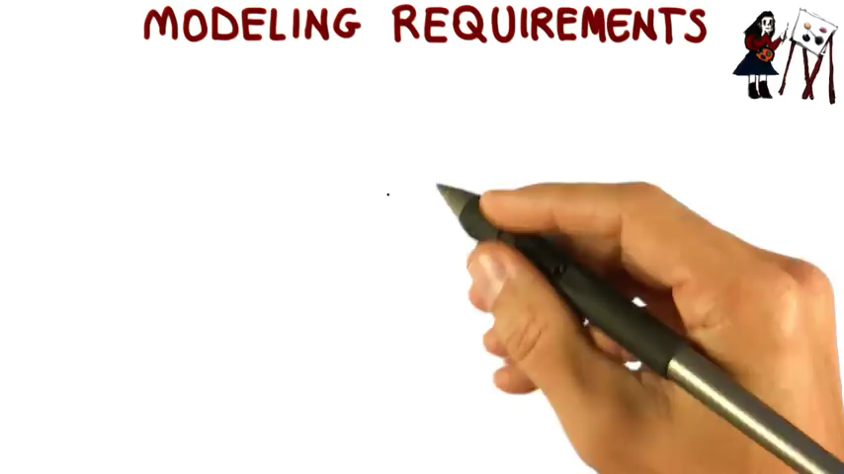
Video – Modeling Requirements
Notes:
Interesting ! Not shown in this chapter of the ebook

Slide 36
REFINING REQUIREMENTS (Analysis)
Develop ideas for solving the user’s problems.
You need to distill the goals (what the customers need to do) into approaches (how the application will do it).
Figure out how the users will select records to edit, what screens they will use, and how they will navigate between the screens.
Those decisions will lead to requirements describing the forms, navigation techniques, and other features that the application must provide to let the users do their jobs.

Slide 37
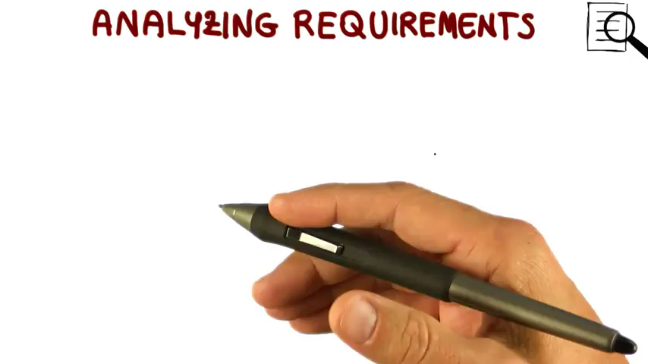
Video – Analyzing requirements

Slide 38
RECORDING REQUIREMENTS
You can just write the requirements down as a sequence of commandments
User Stories
A user story is exactly what you might think: a short story explaining how the system will let the user do something.
The scope of each story should also be limited so that no story should take too long to implement
Use Cases
A use case is a description of a series of interactions between actors. The actors can be users or parts of the application.
Prototypes
mockup of some or all of the application.
evolutionary prototype
throwaway prototype
Requirements Specification: How formally you need to write up the requirements depends on your project.

Slide 39
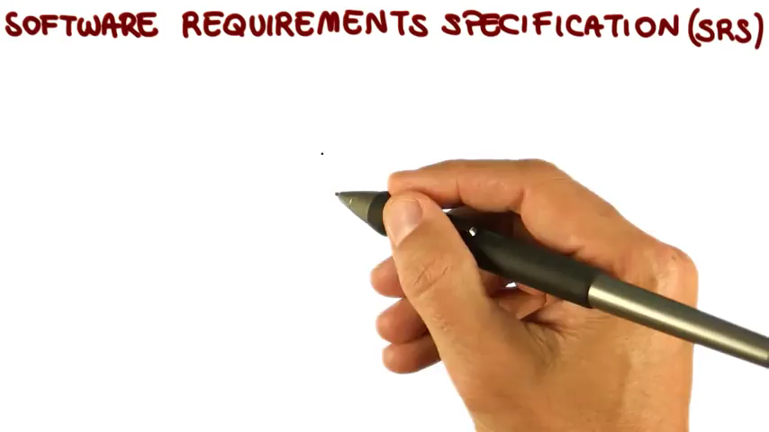
Video – SRS

Slide 40
VALIDATION AND VERIFICATION DO NOT CONFLICT
Requirement validation (during Analysis) is the process of making sure that the requirements say the right things.
Requirement verification is the process of checking that the finished application actually satisfies the requirements.

Slide 41
CHANGING REQUIREMENTS
In many projects, requirements evolve over time.
Often changes are driven by the customers
Depending on the kind of project, you may accommodate some changes, as long as they don’t get out of hand.

Slide 42
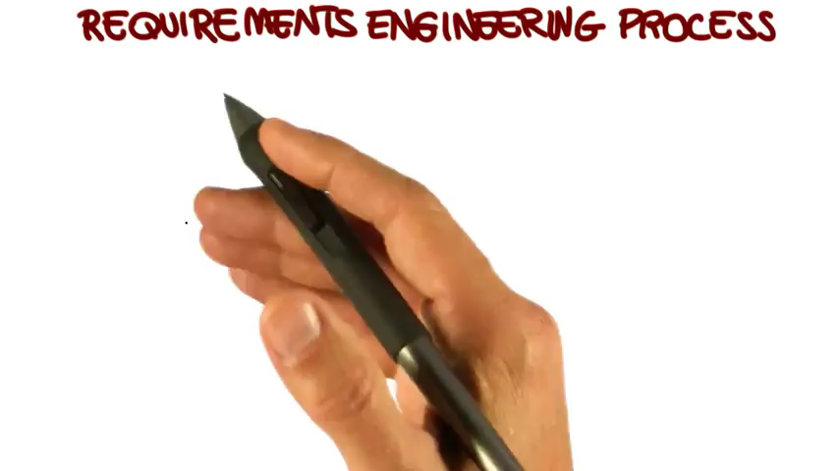
Video – SE Process Summarize

Slide 43
Exercices from the EBook

